Slide 1
INTERIOR DESIGN MANAGEMENT- WEBSITE
Front end project
Sangeetha . M
Batch:5755
Guide : Amruta Deore Kachole

Slide 2
Abstract
Nowadays everything is comes to our hand through internet.Similar way people can choose this website for selecting designs and style the house and their workplaces.First, in the homepage you are having all the options which is register,choose design and services what provided,about us and contact details,etc.Through services you can select your design and package(amount),give your location and click register with your phone number.It will be registered and the team will call the customers as soon as possible.There is an free consultation option also,people can know the best offers through that option.Moreover,it this having all designs for homes,restaurants, etc.

Slide 3
Objective
Making the communication faster
Easy to understand the UI by everyone.
You can register directly no third parties.
Free consultation ensures the convenience to user.
Reduce the paperwork and traffic .

Slide 4
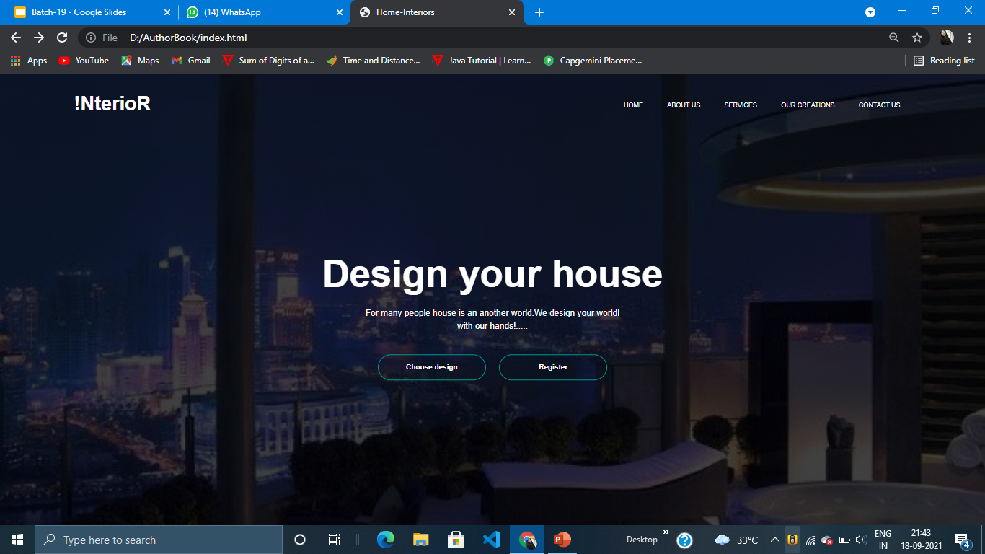

Slide 5
Workflow

Slide 6
Customer visiting the page
According to their requirements(I you need a design for hall plan), people can choose their design in the services section.
There you can see ‘n’ number of designs for your house, people can choose the design and select the pack number and easily register.
In the registration , includes username, phone number, mail-id of user, pack number of the design what customer choose and the location of the customer.
There is also one free consultation page where customer get details from the designer who they like.

Slide 7
Or they just want know our projects means visit the ‘our creations’ page where they can see all our projects.If they like overall quality and performance they may register.
More customers needs feedback, there we added that option also.Every month, it will change.
And we added the procedure for customer convenience for how we process the request. Under that, we give the link for registration.
This website allows user for initial payment once they finish the project confirmation-offline mode.
After the project confirmation, the materials will be installed and handovered.

Slide 8
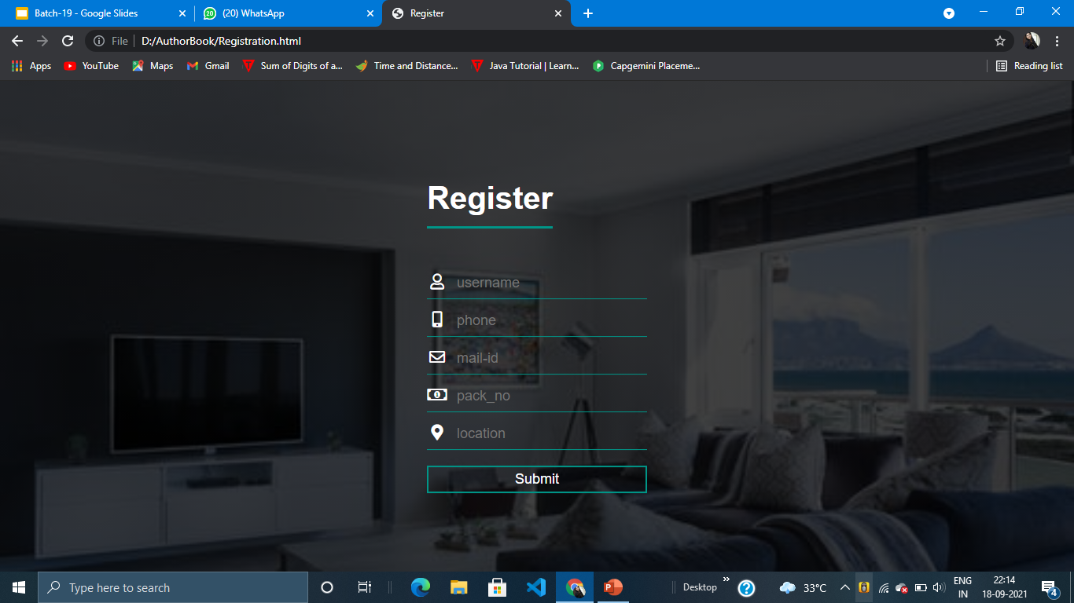
Registration page

Slide 9
Advantages:
Layman can also understand the terms and option in the website.
Post payment option.
Easily register through mail and phone number with corresponding package number.
Free consultation for customers-easily connect with designers.
100+ teams and 4 years warranty.
Also works for big projects like restaurants, bar,hotel,etc

Slide 10
Screenshots

Slide 11
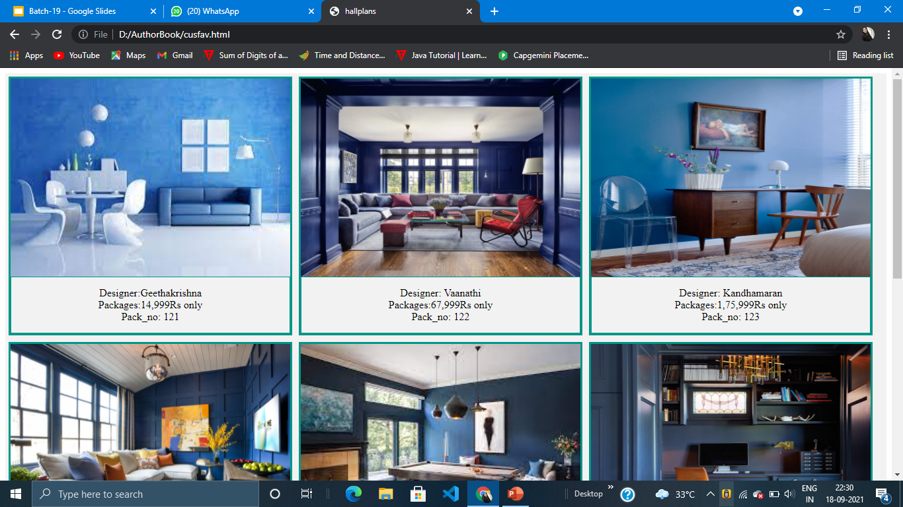
Our creation page:

Slide 12
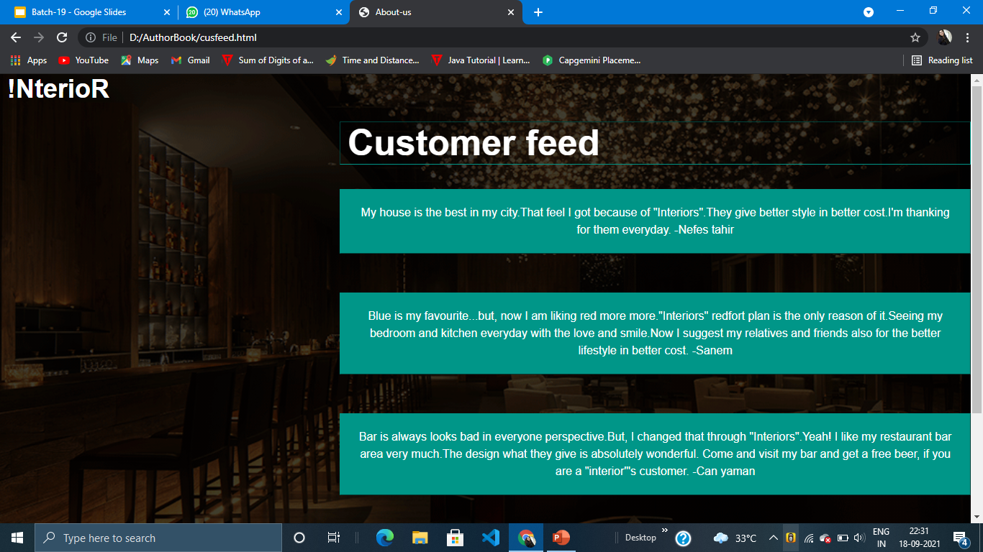

Slide 13
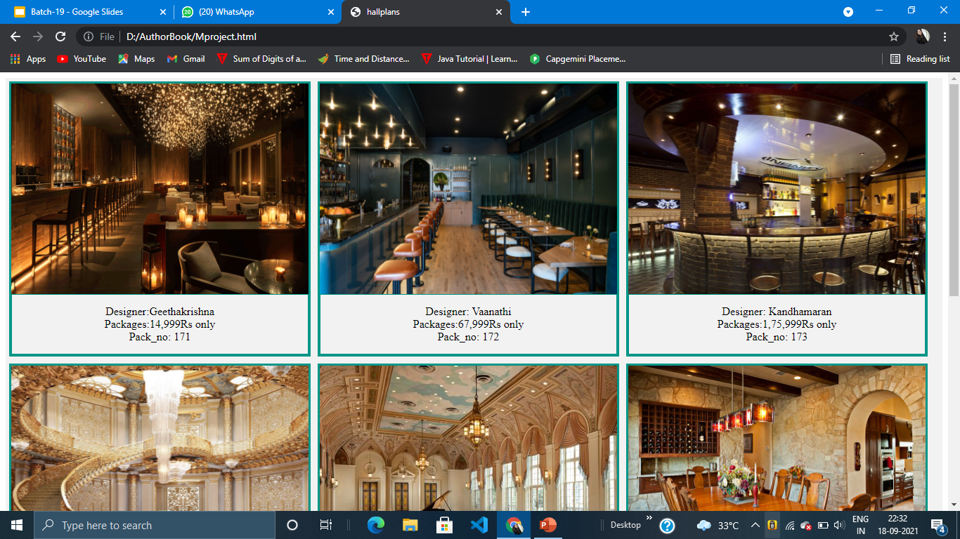

Slide 14
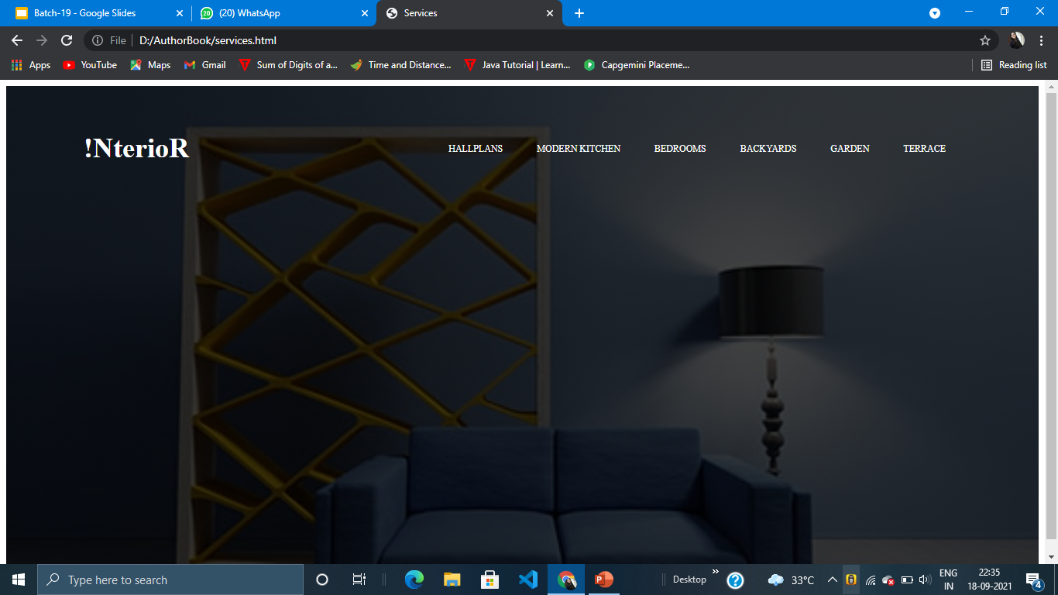

Slide 15
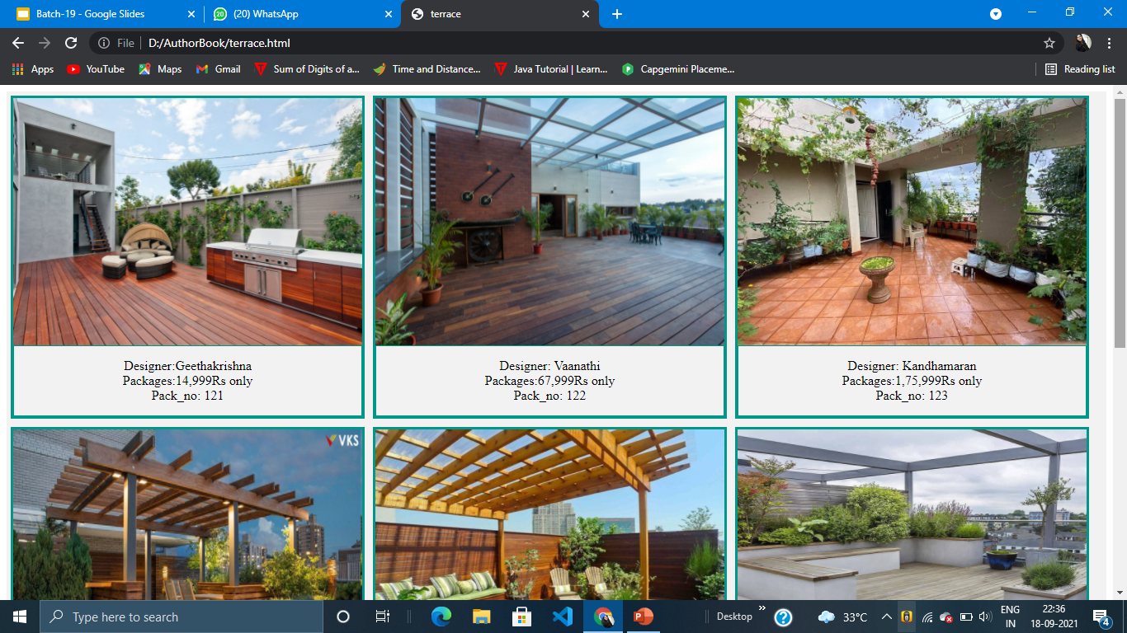

Slide 16
Conclusion
This provide a better website for people searching home interior designs.Here registration is comes as a simple process and becomes easy for everyone. People can choose their designs from home and it provides ‘n’ number of designs. This offers the customers to contact the designers directly through free consultation option.Provides the project procedure customers for their convenience. Also gives customers feedback and provides location information to contact easily.Gives post payment without the initial payment and provides warranty for materials.
Delivering good designs to employees with better cost and better designs-Interiors

Slide 17
References
Homelane interiors website
Wooden Street-Website

